Slide 1

EDA-AMCAT DATA ANALYSIS

Slide 2
About me
I’m Charan Voore pursuing B.Tech branch Computer Science and Artificial Intelligence & Machine Learning.
Data Science combines analytical skills with creativity to uncover insights from data. It’s all about making informed decisions and solving real-world problems. The ability to analyze patterns, predict trends, and visualize information can significantly impact various fields, from healthcare to finance.Hence, the constant evolution of tools and techniques keeps things exciting and challenging!
GitHub:https://github.com/VooreCharan

Slide 3
Description of Data Set
This dataset focuses on the employment outcomes of engineering graduates, containing around 4,000 data points and 40 independent variables.
Dependent Variables:
Salary: Annual earnings of graduates.
Job Titles: Roles secured by graduates.
Job Locations: Geographic areas of employment.
Independent Variables:
Standardized scores in:
Cognitive Skills: Problem-solving and analytical abilities.
Technical Skills: Engineering-specific knowledge.
Personality Skills: Interpersonal and adaptability traits.
Both continuous (e.g., scores) and categorical (e.g., gender, specialization) data.

Slide 4
Problem Statement
The main idea of the project of EDA –AMCAT Data Analysis :
To remove the null values and replace the values by mean and mode.
Find the outliers of the data.
Univariate Analysis are to covert data into PDF, Histograms, Boxplots, Count plots, etc.. understand the probability and frequency distribution of each numerical column understand the frequency distribution of each categorical Variable/Column
Bivariate Analysis describe and detailed to relationships between numerical columns using Scatter plots, hex bin plots, pair plots, etc. Identify the patterns between categorical and numerical columns using swarm plot, boxplot, bar plot, etc. .Identify relationships between categorical and categorical columns using stacked bar plots.

Slide 5
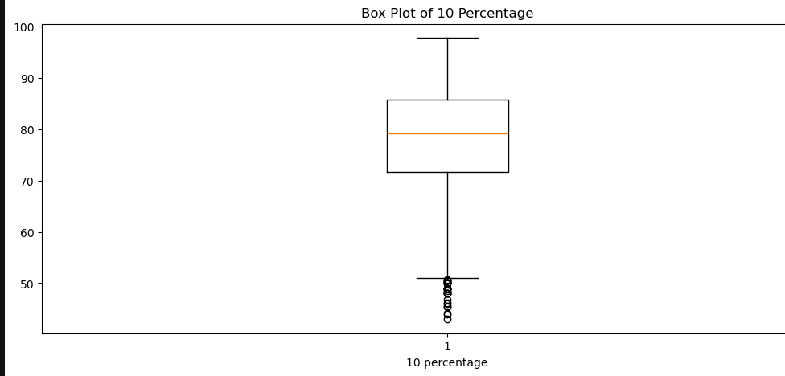
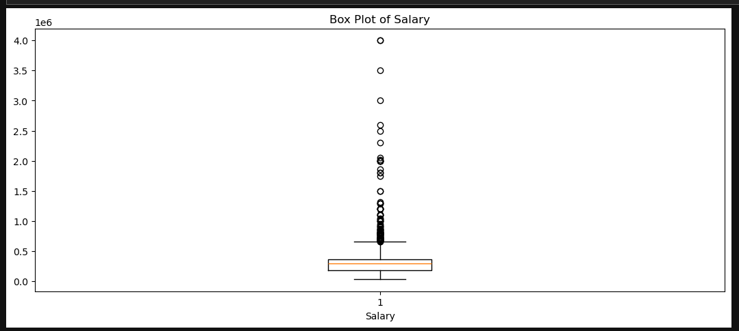
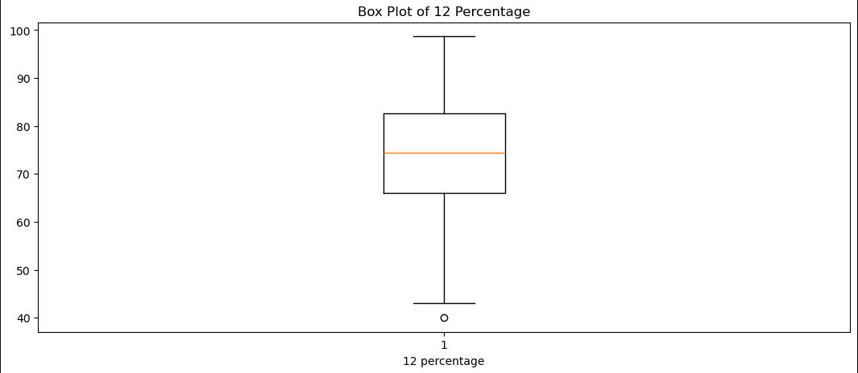
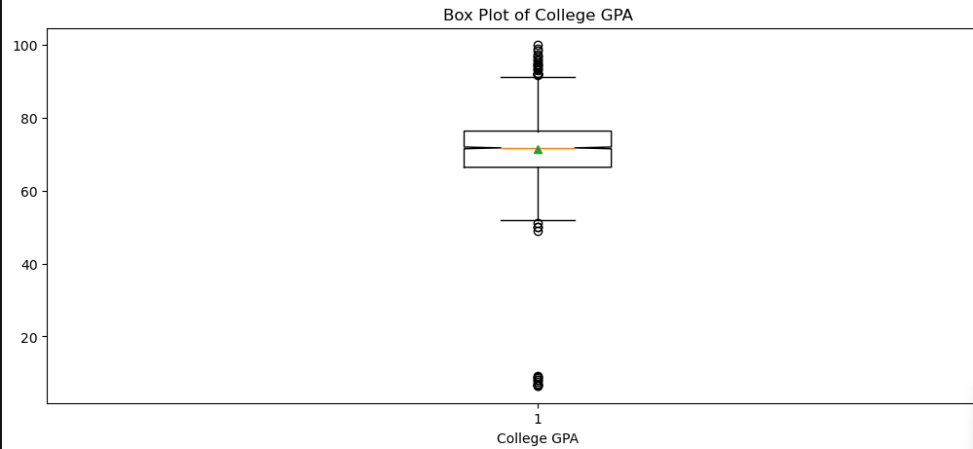
Univariate Analysis

Slide 6
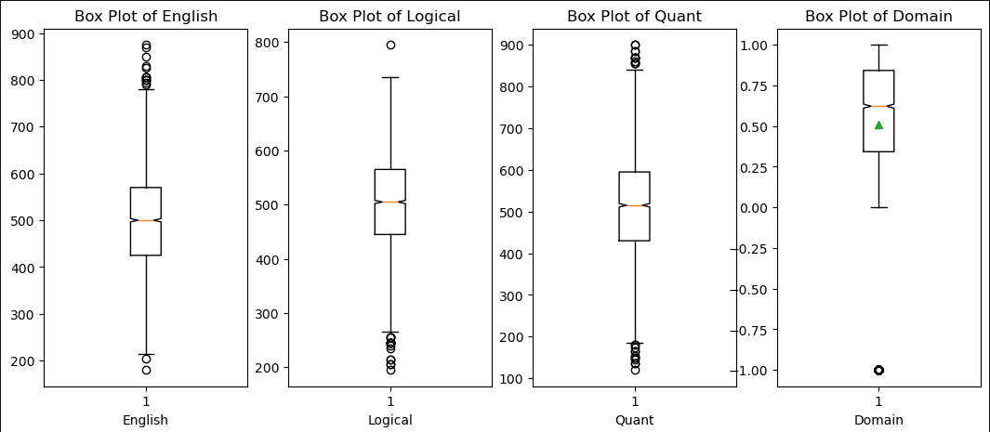

Slide 7
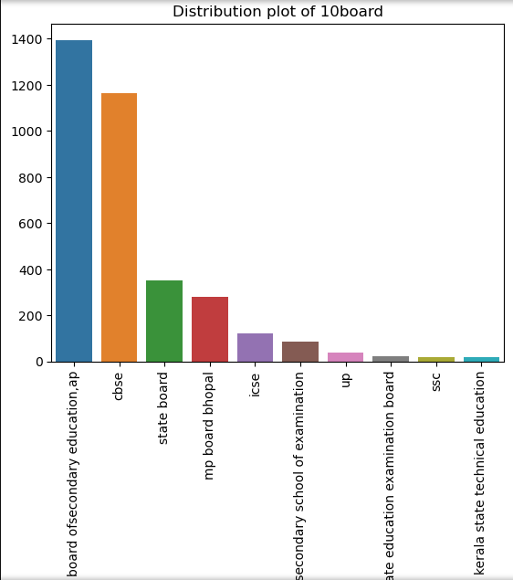
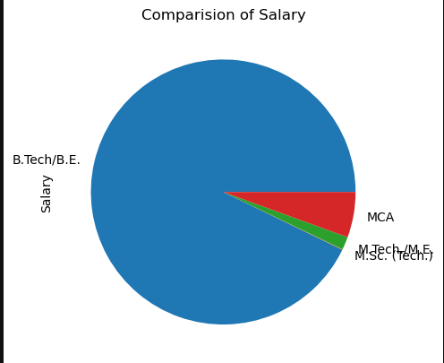

Slide 8
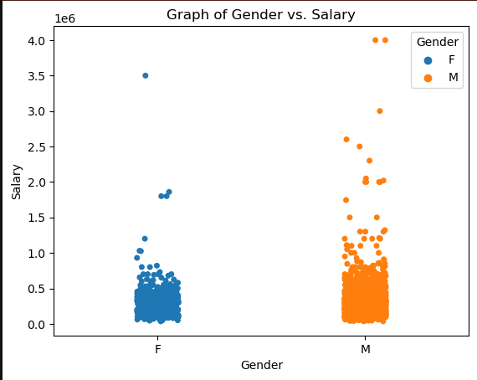
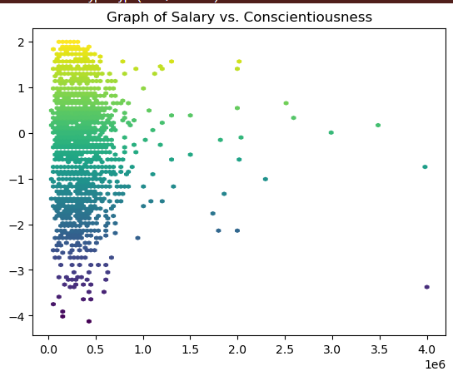
Bivariate Analysis

Slide 9
Conclusion
The exploratory data analysis highlights significant insights regarding salary distributions and the influence of educational specialization and gender on earnings. Key findings include:
A notable positive correlation between experience and salary.
Higher average salaries for graduates in Computer Science.
Gender disparities in specialization preferences, particularly in engineering fields.

Slide 10

THANK YOU

